Slide 1

N.B.K.R.INSTITUTE OF SCIENCE AND TECHNOLOGY
TOPIC:MUSIC PLAYLIST MANAGER TO ADD OR REMOVE SONGS AND SHOW ALL SONGS
Under the guidance of
ASHOK SELVA KUMAR
BY
V.TARUNI(24KB1A05MZ)
S.HITHAISHI(24KB1A05HP)
S.YASMIN/24KB1A05JT)
T.RUPARANI(24KB1A05LC)

Slide 2
INTRODUCTION
The Musical Playlist Manager is a simple yet effective application designed to manage a collection of songs, allowing users to add, remove, and display songs dynamically. This project demonstrates the implementation of fundamental data structures in the C programming language, specifically utilizing singly linked lists to manage playlist entries efficiently. In this system, each song is represented as a node in the linked list, containing details such as the song name and artist. The linked list structure allows for dynamic memory allocation, making it easy to expand or shrink the playlist without reallocating the entire data structure.

Slide 3
OBJECTIVE
The primary objective of this project is to develop a music playlist manager that allows users to efficiently manage a collection of songs using a single linked list data structure in the c programming language . the hey functionalities include:
ADD SONG : Enable users to add new songs to the end of the playlist and listen the song what we added.
REMOVE SONG : Allow users to remove a specific song from the playlist and we remove the song by entering the song tittle.
SHOW ALL SONGS : Display the entire list of songs currently in the playlist.

Slide 4
Why we choose c programming and data structures
C is a foundational language that offers several advantages for implementing data structures:
Low-level memory control : C provides direct access to the memory through pointers that will easily allocate the memory and deallocate,
Efficiency : Generally the programs in c are written faster and have more efficiency for in terms of memory usage.
Probability : C program can be compiled and run on various platforms with minimal changes.
Education value : Implementing the data structures in c helps in under standing the underlying mechanism and pointer usage for high level languages.
Data structures forms the backbone of efficient software development:
Optimized performance : Even with large datasets ensuring data structures will help to perform efficiently.

Slide 5
Scalability: well-designed data structure allow your application to handle growth in data size with out degradation.
Problem solving skills : DS equips you with the tools to approach the complex problems systematically.
Real-world applications : Many real-world systems rely efficiently on data structures such as data bases.

Slide 6
Algorithm for music playlist manager
1.ADD SONG;
1.CREATE A NEW NODE:
ALLOCATE MEMORY FOR A NEW NODE.
SET THE SONG TITTLE IN THE NEW NODE.
SET THE NEXT POINTER OF THE NEW NODE TO NULL..
2.CHECK IF PLAYLIST IS EMPTY:
IF PLAYLIST IS EMPTY(HEAD==NULL).
Set head pointer to the new node.
Else:
Traverse the last node in the playlist.
Set the next pointer of the last node to the new node.
3.RETURN:
PRINT THE SONG TITTLE.

Slide 7
2.REMOVE SONG
1.check if playlist is empty:
If the playlist is empty(head==null).
Print(”playlist is empty”).
Return.
2.traverse the playlist:
Initialize two pointers : temp(current node )and (previous node).
While temp is not NULL and temp->song tittle is not equal to the given tittle . set previous to temp and temp to temp->next.
3.Check if song is found:
If previous is null . set head to temp->next.
Else: previous->next to temp->next.
REMOVE THE NODE.

Slide 8
3.DISPLAY ALL THE SONGS
1.CHECK IF PLAYLIST IS EMPTY:
I. if the playlist is empty(head==NULL)).
Print(”playlist is empty”).
Return.
2.traverse the playlist:
Initialize a pointer temp to next.
While temp is not NULL : print-temp->song tittle
Set temp to temp->next.
3.Return:
Print( “end of the playlist”).
TIME COMPLEXITY IS Q(N) for all cases in the above program.

Slide 9

THE BELOW LINK IS THE PROGRAM FOR ABOVE ALGORITHM:
The uRL Https://onlinegdb.com/sX_SXrloR
LESSON LEARNT:
1.understanding linked list:
Implementing a playlist manager with a single linked list depends your under standing of this fundamental data structure . each node in the list contains the song tittle and a pointer to next node.
2.dynamic memory allocation:
The program utilizes malloc and free to manage memory dynamically . this approach is crucial for handling data whose size is not known at complete time.
3.Efficient insertion and deletion:
Linked list facilitate efficient insertion and deletion operations, especially when adding or removing elements.

Slide 10
4.Pointer manipulation:
Working with pointer in c is essential for building linked list.
5.user input handling:
The program demonstrates how to handle user input safety using function like fgets and strcspn to read string and remove new line characters. This practice helps in preventing common issues like buffer over flows.
6. Modular programming:
By braking down the program into functions such as add song, Remove song, display playlist and free play list, The code becomes more organized and easier to maintain.

Slide 11

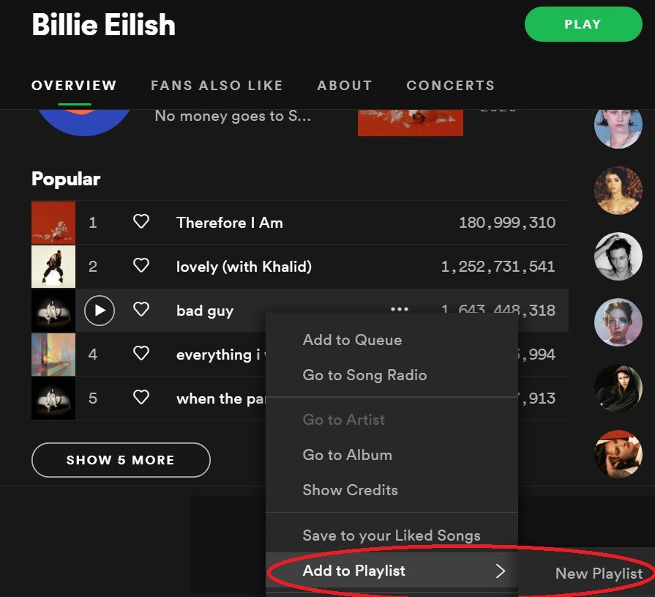
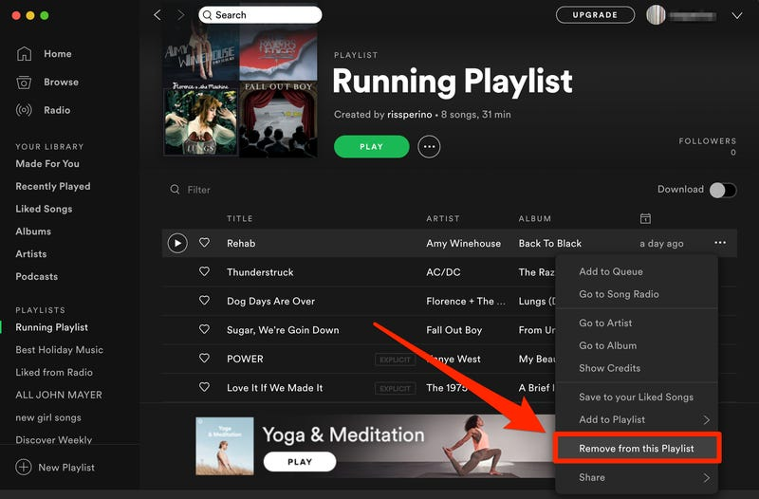


Slide 12
OUT PUT:
1.ADD SONG
2.REMOVE SONG
3.SHOW ALL SONGS
4.EXIT
ENTER YOUR CHOICE:1
ENTER SONG TITTLE:CHOICE OF YOU
ADDED
ENTER YOUR CHOICE:2
ENTER THE SONG TITTLE:CHOICE OF YOU
REMOVED
ENTER YOUR CHOICE:3
PLAYLIST IS EMPTY
ENTER YOUR CHOICE:4
EXITING…

Slide 13


